Slide 1
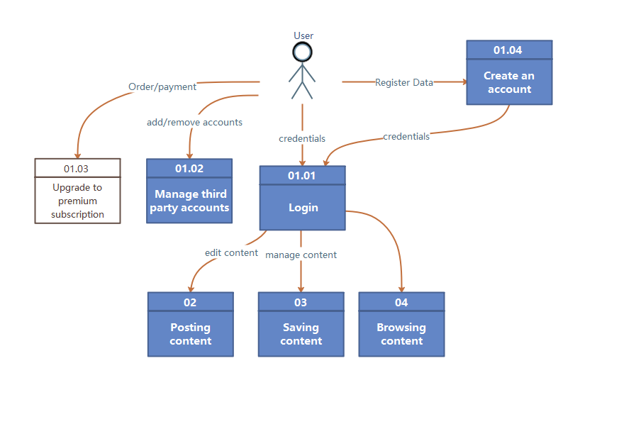
Team5 Data flow diagram(logical) of Stream Feeder

Slide 2
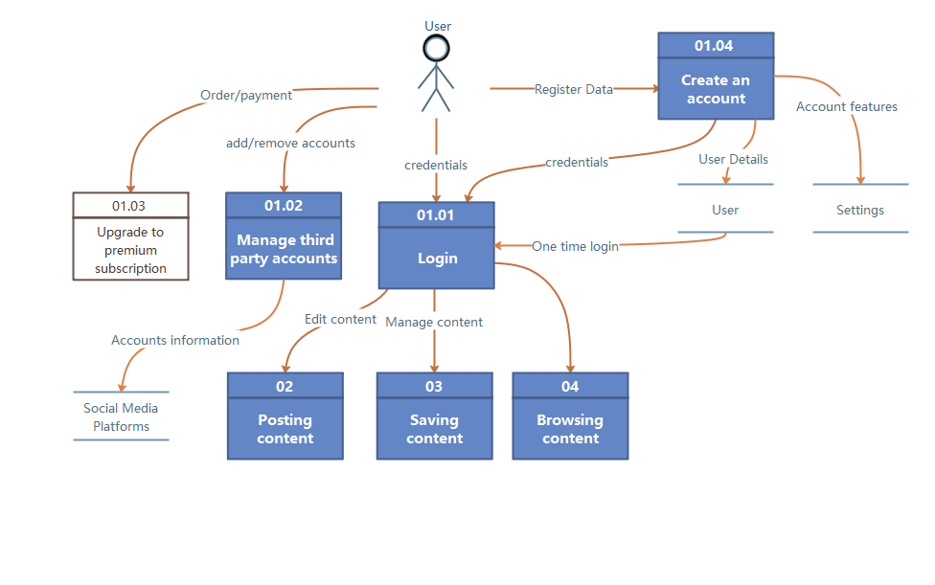
Team5 Data flow diagram(physical) of Stream Feeder

